Slide 1
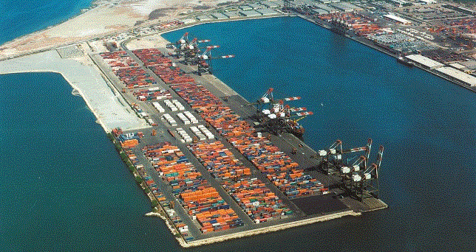
"Jamaica's Logistics Hub: Next Steps”
Presented By: Donovan Wignal
January 2014

Slide 2
JAMAICA’S Logistics Hub

Slide 3
introduction
Paraphrasing prof The Hon. Gordon Shirley Chairman of the Port Authority of JA:
“The strictures of the IMF agreement are shrinking the economy as an unintended consequence in order to fulfil the quantitative requirements EFF and so as a counter balance to this effect is that we need local manufacturing and significant investments in small businesses.”
In the last five years, the MSME sector accounted for the highest percentage of the registered businesses in the country—6,000 annually. In fact, Minister Hylton in a recent Budget presentation declared that the MSME sector had a major role to play in the Government’s growth and development programme. He stated that the key in achieving the desired balance is to ensure that the MSME sector is developed in tandem with the growth of large scale businesses, multinational corporations and enterprises.
Notes:
Late Stage Product Configuration
New supply chain techniques, called late stage configuration or postponement, can be used to alleviate many of the challenges associated with oversupply of apparel and electronics. Apparel and electronics share many common supply chain characteristics. First, both are manufactured in offshore centres a significant distance from the end-consumer. Second, both apparel and electronics have very short product lifecycles of six months or less. Third, both have a high degree of SKU proliferation and customisation. Apparel items such as sweaters are offered in numerous colors and sizes. Electronics such as the mobile phone are increasingly being personalised and configured to meet individual consumer tastes.

Slide 4
Jamaica’s Logistics Hub Initiative

Slide 5
JAMAICA’S Logistics Hub
Next steps
‹‹ Position Jamaica to capitalize on its competitive advantage as the major transshipment port of the Caribbean for added value logistics activities ››
3rd party logistics
Packaging, warehousing, shipping, late stage configuration
4th party logistics Supply chain management (e.g. production and distribution flows, organization of supply)
Reverse logistics Recycling and reconditioning, Collection of unsold products, reintroduction into production cycles and market
Supportive Activities Consulting, education and training
Notes:
Late Stage Product Configuration
New supply chain techniques, called late stage configuration or postponement, can be used to alleviate many of the challenges associated with oversupply of apparel and electronics. Apparel and electronics share many common supply chain characteristics. First, both are manufactured in offshore centres a significant distance from the end-consumer. Second, both apparel and electronics have very short product lifecycles of six months or less. Third, both have a high degree of SKU proliferation and customisation. Apparel items such as sweaters are offered in numerous colors and sizes. Electronics such as the mobile phone are increasingly being personalised and configured to meet individual consumer tastes.

Slide 6
JAMAICA’S Logistics Hub
CHANNELS
Market Jamaica as ideal geographical location (one hour and twenty minutes by air from Miami)
Build up administrative and regulatory framework
Facilitate the creation of new activities by granting land access
Improve logistics know-how

Slide 7
JAMAICA’S Logistics Hub
LOGISTICS INDUSTRY IN JAMAICA & THE MSME
Just over 20 entities (less than half exclusively in logistics)
Around 2,000 direct and indirect jobs (0.1% of total workforce)
Majority of companies located in the city of Kingston
Significant sales and value added in manufacturing come from MSMEs

Slide 8
JAMAICA’S Logistics Hub
Current and future trends
Following a spectacular drop in the sector’s growth in 2009, came a leveling off up to 2nd Q2013, however, economic instability is casting a cloud over the industry’s outlook
The downturn has impacted some commodities more significantly than others
Jamaica’s trade deficit during the first nine months of 2013 was US$3,441.0 million, compared to US$3,708.0 million in the same period for 2012, a fall of 7.2 per cent (STATIN). However, Jamaica’s strongest growth is anticipated on trade lanes coming out of Asia
Notes:
Globalization and outsourcing of logistics services created double digit revenue growth in the industry in the early part of the 21st century. However, the economic downturn which made itself felt across the world in 2008 resulted in a dramatic drop in the sector’s growth in 2009, and it was all of a sudden confronted with some of the most challenging market climates in history.

Slide 9
JAMAICA’S Logistics Hub
MARKET TRENDS
By what has been happening locally and globally: the processing of marijuana for its lesser known attributes, on the agenda of many in some quarters
20 states in America have legalised it
Debate is now raging as to whether to legalize same
Technology trend will also continue on an upward swing with products / devices out of North America and Asia
Opportunities are somewhere in all of this
Sensible logistics are going to be needed to now legally move its products and by products to market.

Slide 10
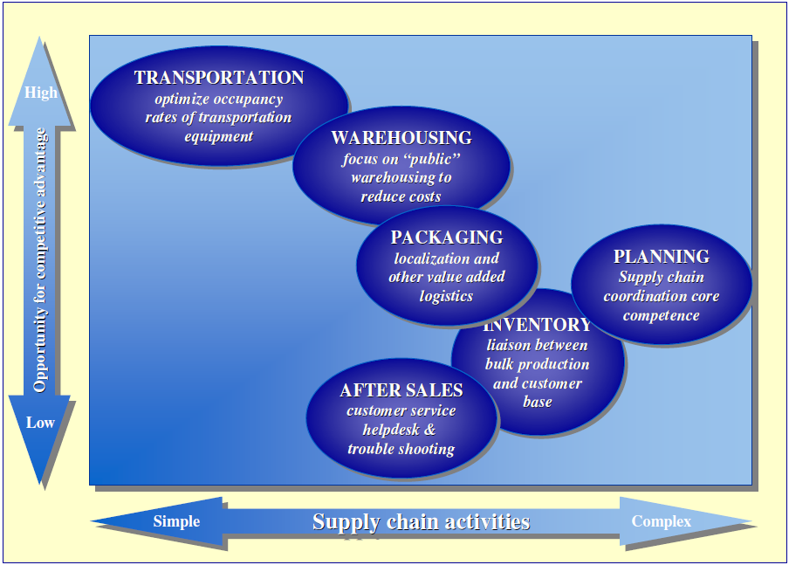
JAMAICA’S Logistics Hub
MARKET TRENDS – MSME opportunities
Information and Communications Technology(ICT);
Aerospace and aviation:
Ship and oil rig repair;
Maintenance repair and overhaul (MRO) for airplanes;
Marine and offshore – dry docking
Logistics and shipping.
Chemicals and petrochemicals;
Biotech and pharmaceutical; fashion and apparel;
Entertainment and media;
Hospitality: food and beverage
Types Of Supply Chain Activities
Source: Groenewout Consultants & Engineers
Notes:
Opportunities from the establishment of the logistics hub
“With the development of the logistics hub, the many opportunities for
MSMEs will be almost inexhaustible. These include areas such as: aerospace and aviation: maintenance repair and overhaul (MRO) for airplanes; biotech and pharmaceutical; fashion and apparel; Information and Communications Technology(ICT); chemicals and Petrochemicals; entertainment and media; marine and offshore – dry Docking, ship and oil rig repair; food, beverage and hospitality; local and international logistics and supply chain management, warehousing, distribution and shipping. Customs brokering, freight forwarding, courier services, local and international.

Slide 11
JAMAICA’S Logistics Hub
Employment opportunities in the logistics sector
warehousing and warehouse management;
security;
drivers/trucking services;
customer support;
supply/value chain management services;
ICT support, including programmers;
human resources supply (job placement agency) &management;
assembly of consumer goods (e.g. electronics);
intellectual property monitoring and management services;
engineering; and food preparation and food processing.

Slide 12
JAMAICA’S Logistics Hub
challenges
Very low Global Competitiveness Index
an inefficient bureaucracy
high energy costs
the need for appropriate tax reform
the need for a higher level of business literacy
the need for a more enabling environment
lack of law and order
Financing - Because the risk is high, banks are cautious and credit processes are complex.

Slide 13
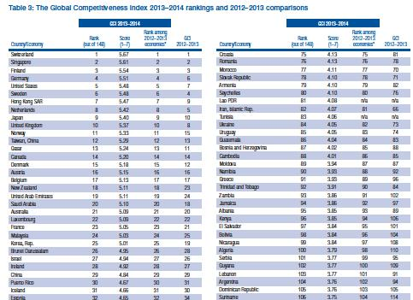
JAMAICA’S Logistics Hub
Ranked 92 out of 148 economies
The Global Competitiveness Index 2013–2014 rankings and 2012–2013 comparisons
Source: http://www.oecd.org/

Slide 14
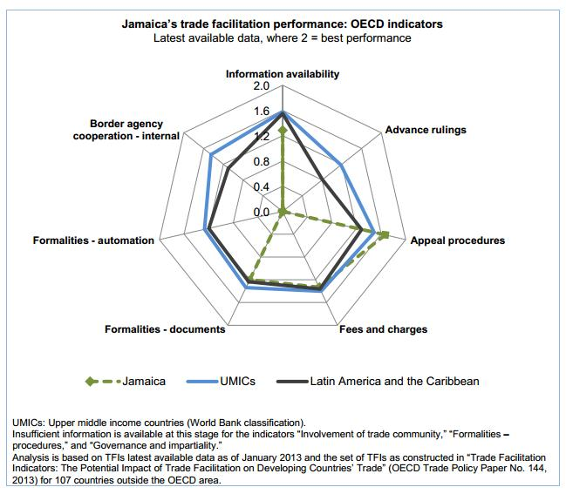
JAMAICA’S Logistics Hub
“Jamaica’s performance for advance rulings, information availability, automation and internal border agency co-operation is below the average for upper middle income countries and Latin American and Caribbean countries”.
OECD (Organisation for Economic Co-operation and Development)
Source: http://www.oecd.org/
Notes:
OECD Trade Facilitation Indicators
OECD has developed the following indicators to assess trade facilitation policies.
• Information Availability: Publication of trade information, including on internet; enquiry points.
• Involvement of the Trade Community: Consultations with traders.
• Advance Rulings: Prior statements by the administration to requesting traders concerning the classification, origin, valuation method, etc., applied to specific goods at the time of importation; the rules and process applied to such statements.
• Appeal Procedures: The possibility and modalities to appeal administrative decisions by border agencies.
• Fees and Charges: Disciplines on the fees and charges imposed on imports and exports.
• Formalities-Documents: Simplification of trade documents; harmonisation in accordance with international standards; acceptance of copies.
• Formalities-Automation: Electronic exchange of data; automated border procedures; use of risk management.
• Formalities-Procedures: Streamlining of border controls; single submission points for all required documentation (single windows); post-clearance audits; authorised economic operators.
• Internal Co-operation: Co-operation between various border agencies of the country; control delegation to Customs authorities.
• External Co-operation: Co-operation with neighbouring and third countries.
• Governance and Impartiality: Customs structures and functions; accountability; ethics policy.
Trade facilitation describes the manner in which traders receive goods across borders with the least possible delay or bureaucracy, and is one of the main factors of Jamaica’s economic growth. It relates to the simplification and harmonization of international trade procedures as they relate to clearance processes, documentation, payment methods, and procedures of non-customs agencies.

Slide 15
JAMAICA’S Logistics Hub
HOW DO WE PLAN TO MEET THESE CHALLENGES?
Enhance and foster jamaica’s competitiveness
Cluster for logistics
An initiative between the institutional parties and the private sector to to assess and strengthen Jamaica as a logistics hub in the Caribbean
Maritime Cluster
An initiative of the private sectors to promote the maritime sector

Slide 16
JAMAICA’S Logistics Hub
HOW DO WE PLAN TO MEET THESE CHALLENGES?
Make best use of the current facilitative approach
Seek to work closer with the Ministry of Industry, Investment & Commerce to ensure development of the spirit of entrepreneurship to stimulate the consolidation of the MSME sector.
Immediately tackle the crisis of management which exists, by joining forces with relevant organizations and speedily implement a programme to address the urgent need for an improved level of business literacy throughout the sector.
Notes:
In so doing, we will improve our external awareness of local and international business environments, with better internal planning to identify the opportunities that will be spawned by the wide spanning Jamaican logistics hub.

Slide 17
JAMAICA’S Logistics Hub
HOW DO WE PLAN TO MEET THESE CHALLENGES?
Clear separation of regulatory functions from commercial activities
Full benefits of private sector participation in operations and infrastructure financing achieved only through a balanced formula
Responsible public authority management
Prevent the development of local monopolies and rent-seeking practices
Explicit regulatory frameworks for unavoidable monopoly
Ownership issues within the framework of public/private partnerships for development of port facilities (BOT, BOO, BOOT, etc.) need to be carefully addressed
Notes:
Clear separation of regulatory functions from commercial activities is at the core of the new public/private partnerships being developed in the ports sub-sector: full benefits of private sector participation in operations and infrastructure financing will be achieved only through a balanced formula where an appropriate regulatory framework, managed by a responsible public authority, ensures the benefits to be expected from the new operating pattern will flow to all potential beneficiaries.
Competition conditions between ports, or within ports when possible, need to be monitored by public authorities to prevent the development of local monopolies and rent-seeking practices; when true monopoly situations are unavoidable, explicit regulatory frameworks, including tariff policies, must be implemented to ensure the economic outcome conforms to public interest.
As a consequence of (i) the spreading of port concessions in specific traffic niches, like container terminal operations, and (ii) the relatively few number of international professional operators in the market, a new form of competition limitation develops along regional coastlines, crossing countries boundaries. It becomes now possible to anticipate that in the short run, one or two terminal operators may control a string of terminals on a given range, therefore establishing a new case of dominant position at a regional level. The appropriate answer to this situation should at first sight come from regional economic cooperation bodies, which should therefore be vested with specific authority regarding competition in transport services on a regional scale.
Ownership issues within the framework of contractual public/private partnerships for development of port facilities (BOT, BOO, BOOT, etc.) need to be carefully addressed with a view to provide potential investors with the comfort they need without jeopardizing long-term public interest; in particular, ultimate public ownership of shore and port land should be maintained.

Slide 18
Jamaica’s logistics hub
CONCLUSION
So in closing distinguished ladies and gentlemen,
With this new, positive approach to the development of our sector, the now visible attention to MSMEs, how the SME sector factors in the economic recovery of Jamaica in general, and our place in the evolution of the logistics hub, with the right guidance, the right incentives, the right operational climate; and an enabling , facilitative business environment, Jamaica’s MSME sector can factor powerfully in this game changing logistics hub project; thereby sowing the seeds for Jamaica’s economic recovery.
“We must now prepare ourselves for the opportunities to come— with the necessary training and improved business skills, knowledge and technologies that will allow us to be more competitive.

Slide 19
Jamaica’s logistics hub
The challenge is ours. For our sake, for Jamaica’s sake……
SUCCEED WE MUST AND WE WILL!

